Slide 1
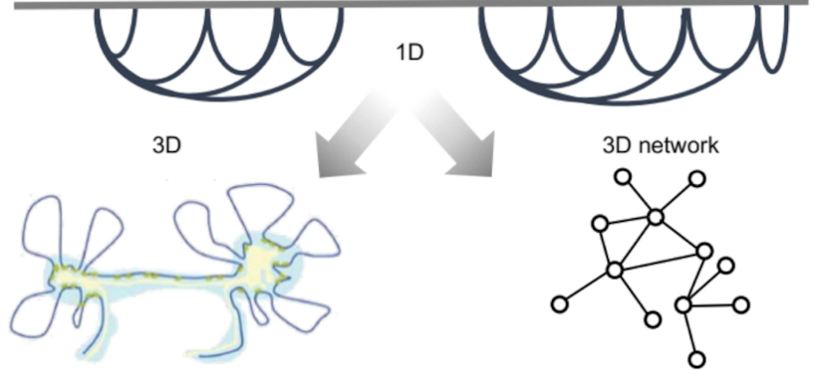
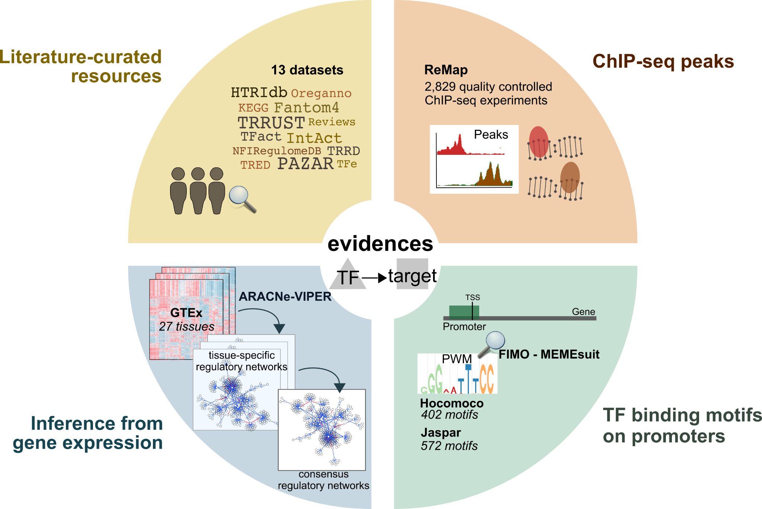
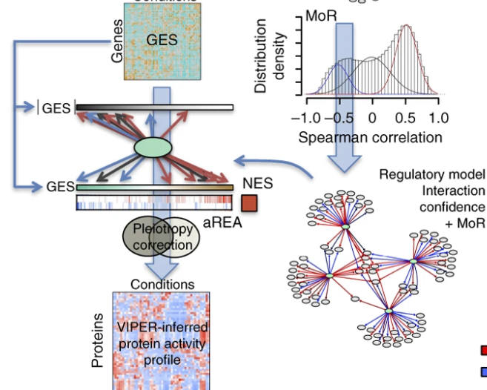

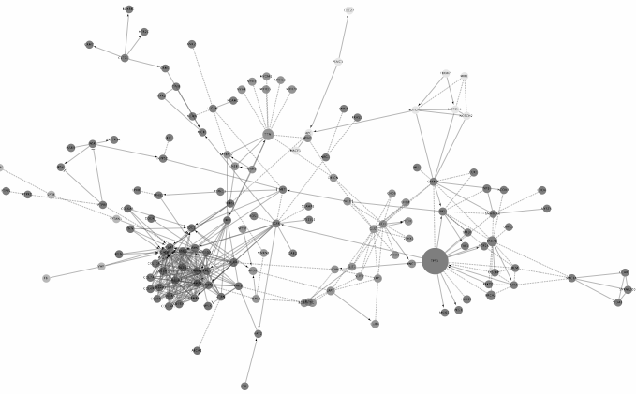
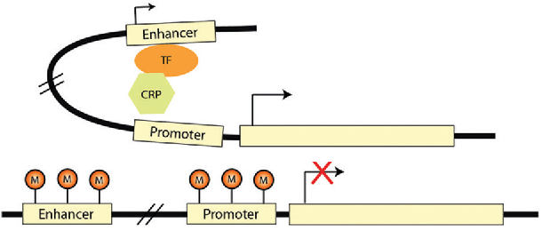
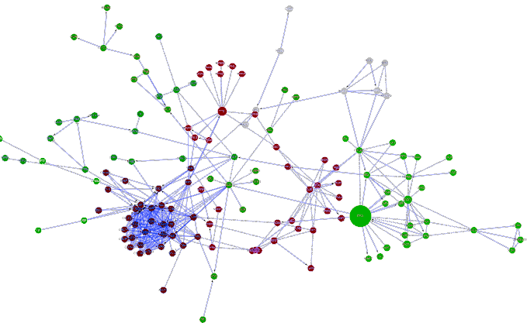
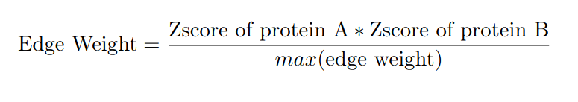
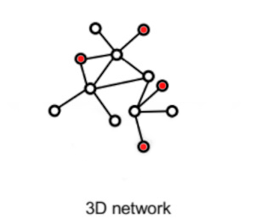
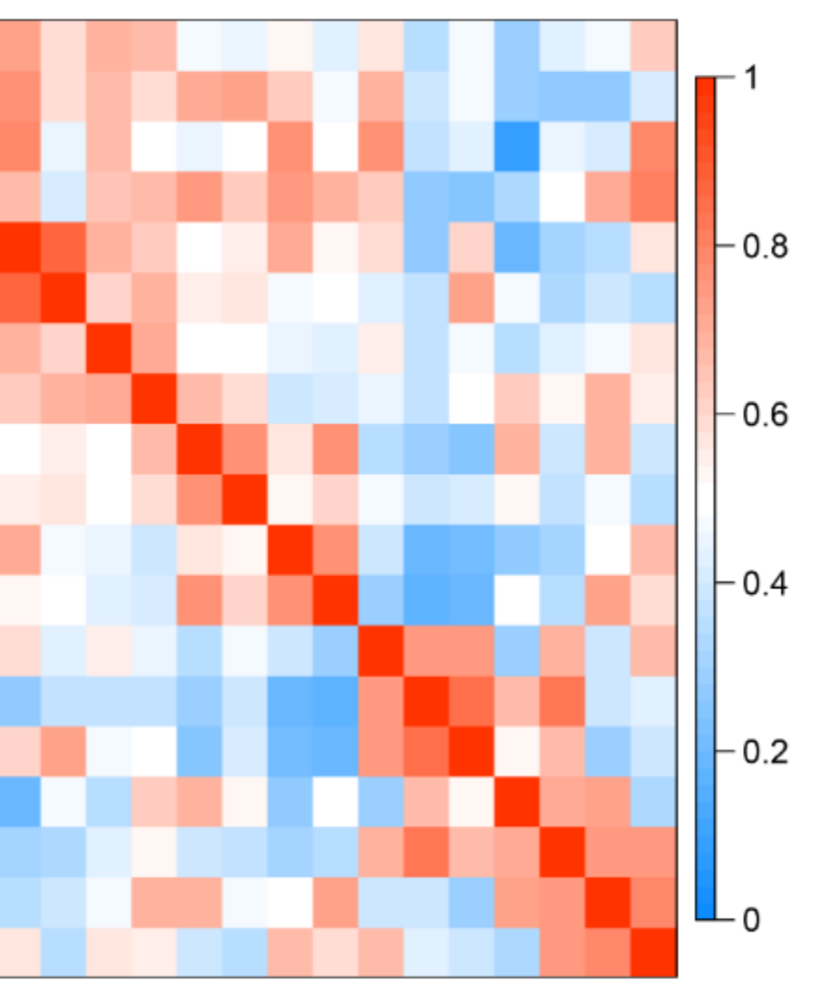
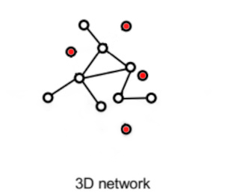
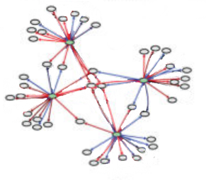
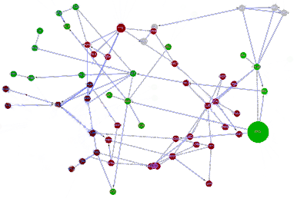
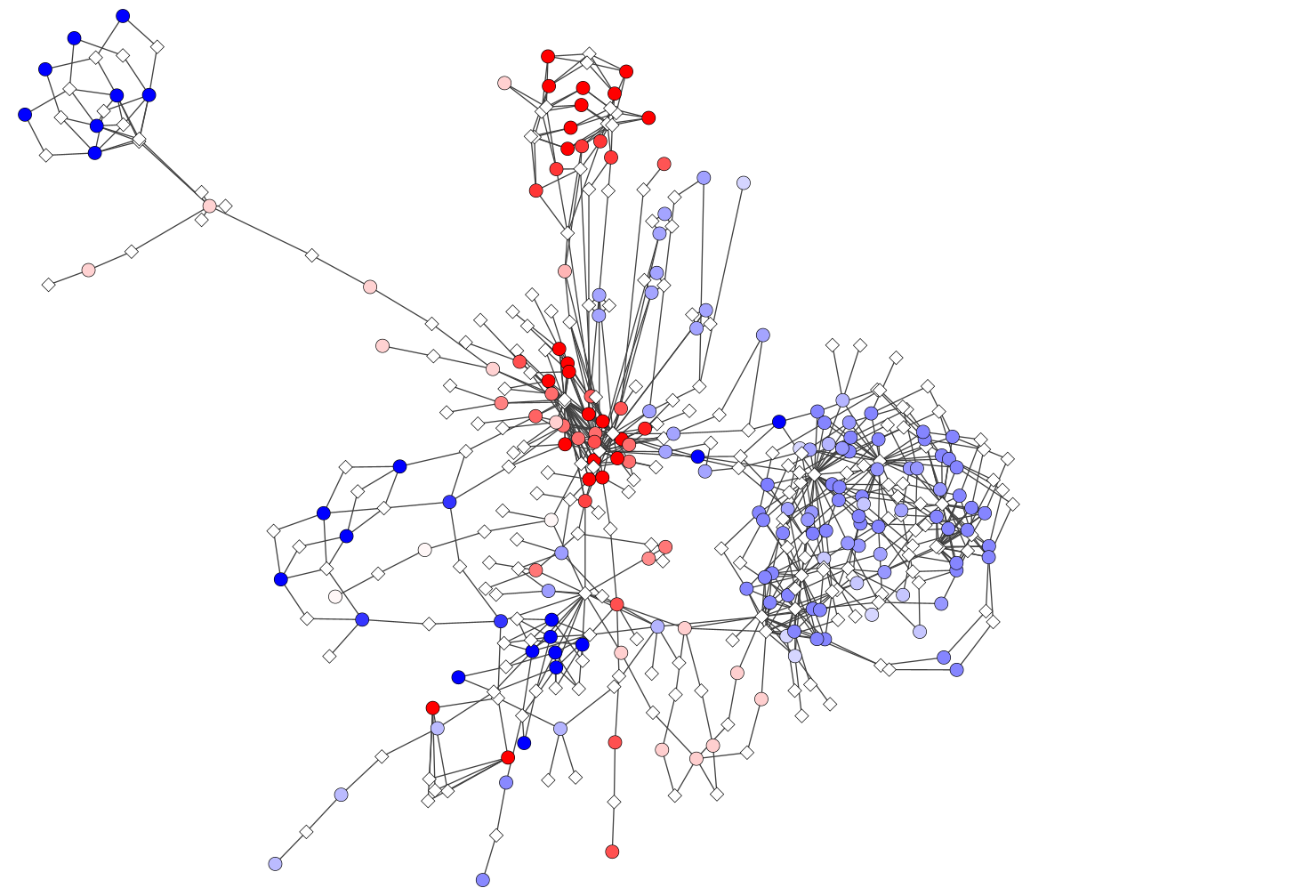
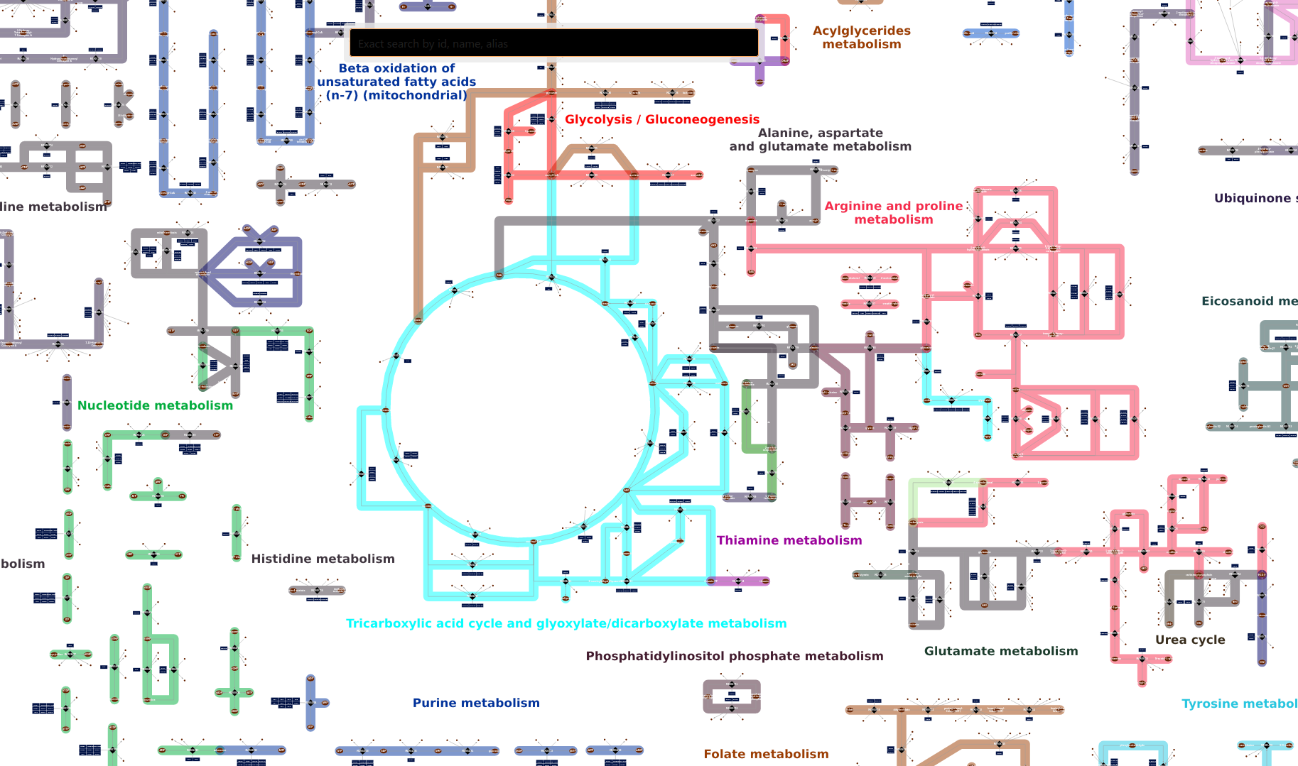
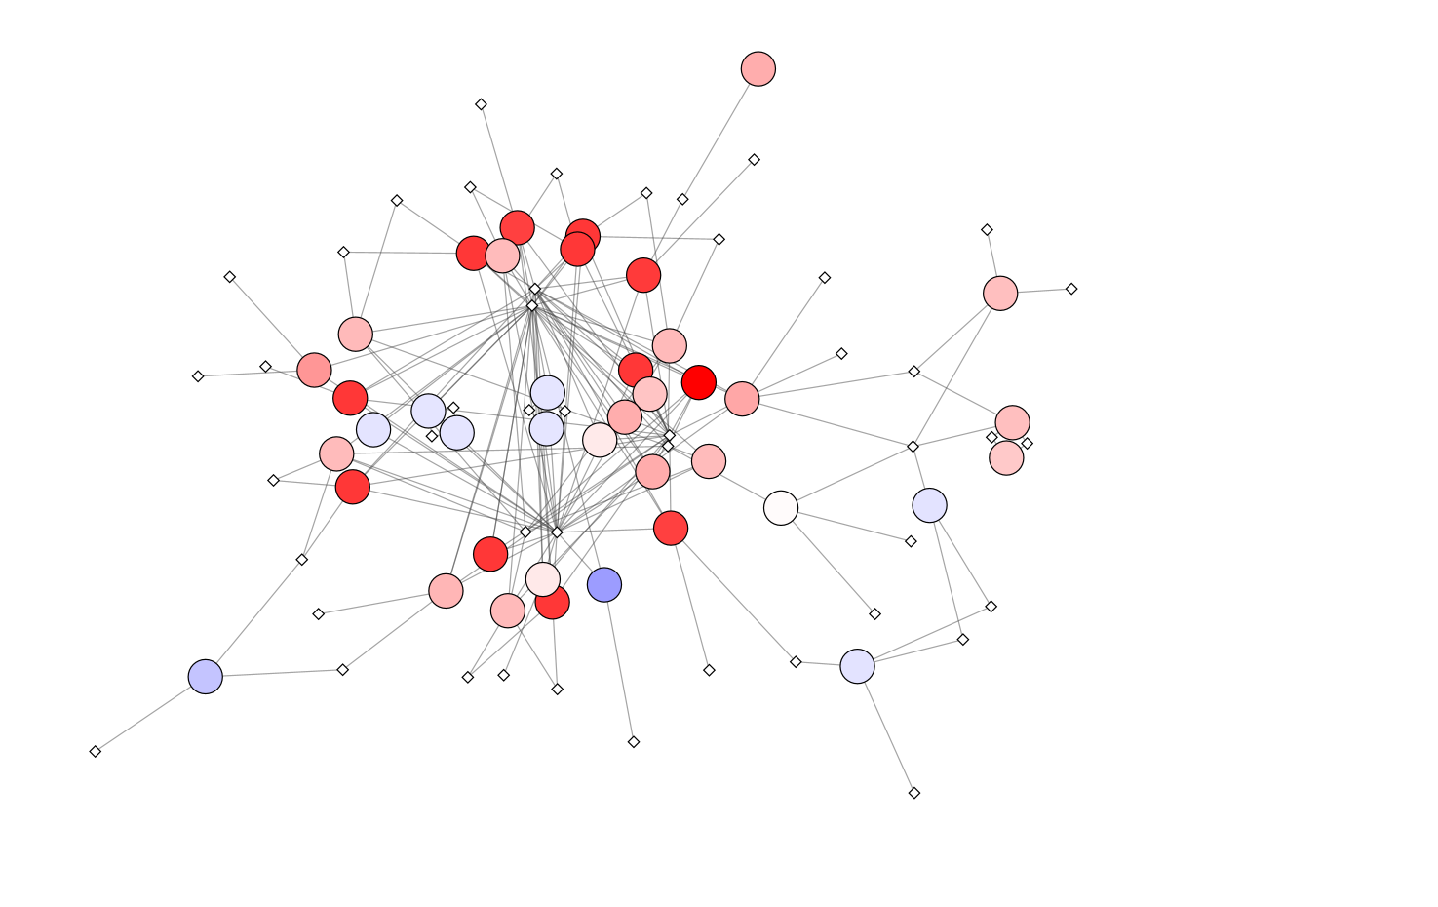
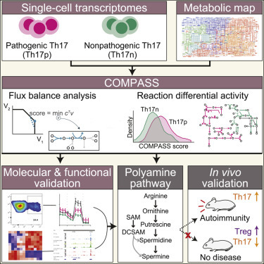
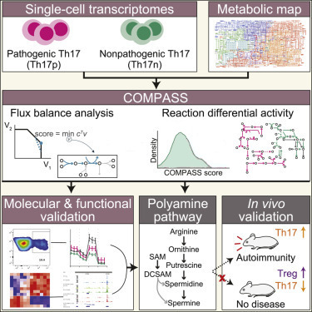
Layer 1
b. Layer 2
c. Layer 3
3D chromatin contact map from 7 primary myeloid cell lines
Transcriptomics
Regulonlaml
Proteomics
Functional protein - protein interaction network fPPI
Normalization
Data imputation
of missing values
Z Score of abundance
DNA methylomics
Mapping of protein abundance on fPPI
Mapping on chromatin fragments
Inference of TF activity
Gene regulatory network
DNA methylation prevent enhancer promoter interaction
Inhibit gene expression
Hypermethylated
Top 25k correlated TF activity - Gene expression interactions
Top 25k weighted Protein - Protein interaction
Hypomethylated
Methylated interactions removed
TF activity & Gene target expression correlation
Transcriptomics
Human genome-scale metabolic models
Top 25k most active reactions - metabolites
COMPASS Algorithm
d. Layer 4
Mapping of reactions activities on metabolic network
Filtering
most actives reactions
e. Multilayer
of reactions activities
Gene promoter
Other ends
Layer 1
Association of chromatine fragments to Gene promoter
Establishment of Gene promoters/chromatin fragments – Genes intra-layer links
Gene promoter – Gene
intra-layer
Gene
Layer 2
Negative correlation
Transcription factor
Positive correlation
Association of Protein coding genes to Protein
Gene - Protein association intra-layer
Protein
Layer 3
Association reaction to enzyme
Establishment of Enzyme/reaction to Protein intra-layer links
Protein - Enzyme association intra-layer
Reaction
Metabolite
Layer 4

